Slide 1

Robotic Process Automation using UiPath StudioX
HITESH KUMAR SHARMA
Technical Instructor & Consultant

Slide 2
ABOUT ME
Industry Experience: 13 Years ( 3 Years in RPA, 5 Years in Data Analytics & 5 years in DevOps )
Core Technical Domains: UiPath RPA, DevOps, Cloud Computing, Data Analytics
Academic Qualifications: Ph.D. (CSE), M.Tech (CSE)
Certifications:
UiPath RPA Certified Associate
Docker Certified Associate
Neo4J Certified Associate
Maven Certified Professional
4 Books Published
28 Patents Published
02 Copyright Published
HITESH KUMAR SHARMA
Technical Instructor & Consultant

Slide 3

Introduction to RPA
StudioX Citizen Developer Journey and Working with StudioX
Activity Recording, UI Automation in StudioX
Decisions, Iterations, and Scenarios in StudioX
File, Folder Automation in StudioX: Microsoft Excel Automation
Email Automation in StudioX
Handle Errors in StudioX
COURSE OBJECTIVES

Slide 4
8 Hours Daily of Instructor-Led Training
Slides Based Content
Whiteboard/ Pen Tab based Interaction
Hands-on Live Demo
Daily Recap
Daily Session Slides
Lesson-End Assignment
Course-End Projects
DELIVERY MODE

Slide 5
Knowledge of Excel
Knowledge of E-Mail Handling
Basic Knowledge of Working on a Software
PRE-REQUISITES

Slide 6
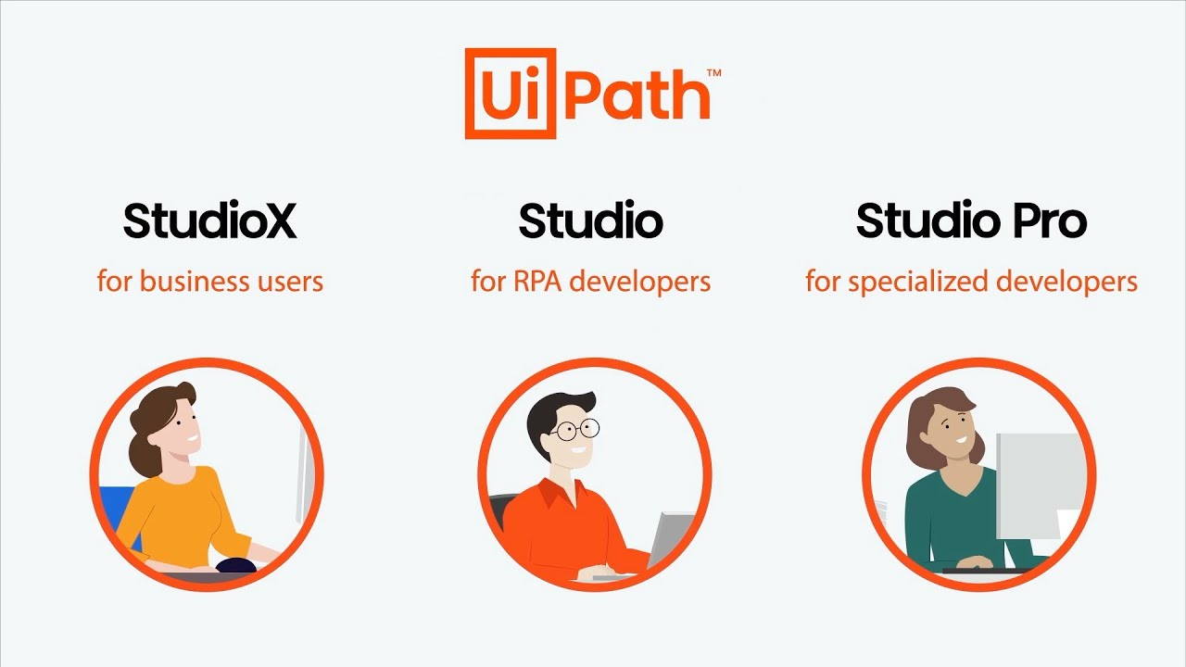

HANDS-ON ENVIRONMENT

Slide 7
1. Introduction to RPA
What is RPA?
Industrial Scenario
Reviews on Tools/Platforms
UiPath StudioX Use Cases
Domain Specific Applications using UiPath StudioX

Slide 8
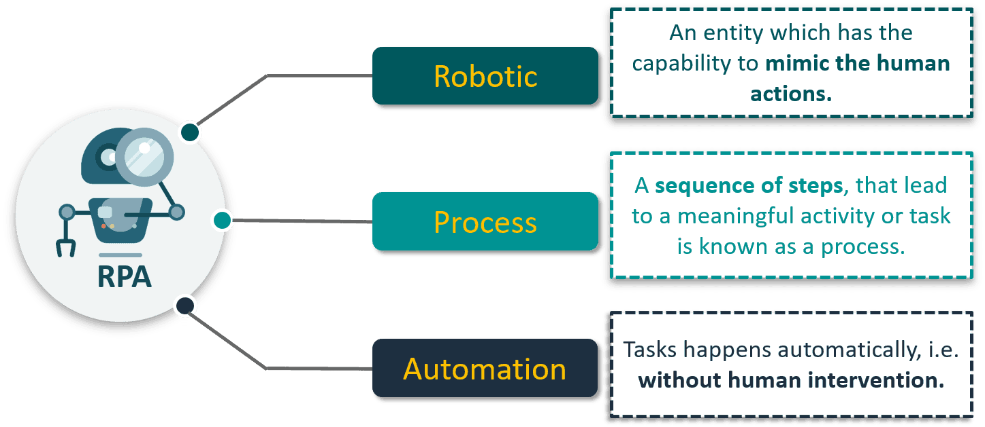
What is RPA?

Slide 9
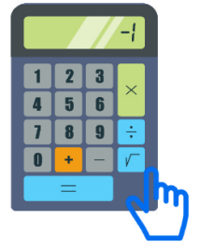
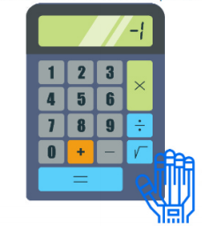
What is RPA?
Manual System
RPA
Human feeds the number and calculator perform operations
RPA replaces Human Intervention by software robots
Bots feed the number and calculator perform operations
HUMAN
BOT

Slide 10
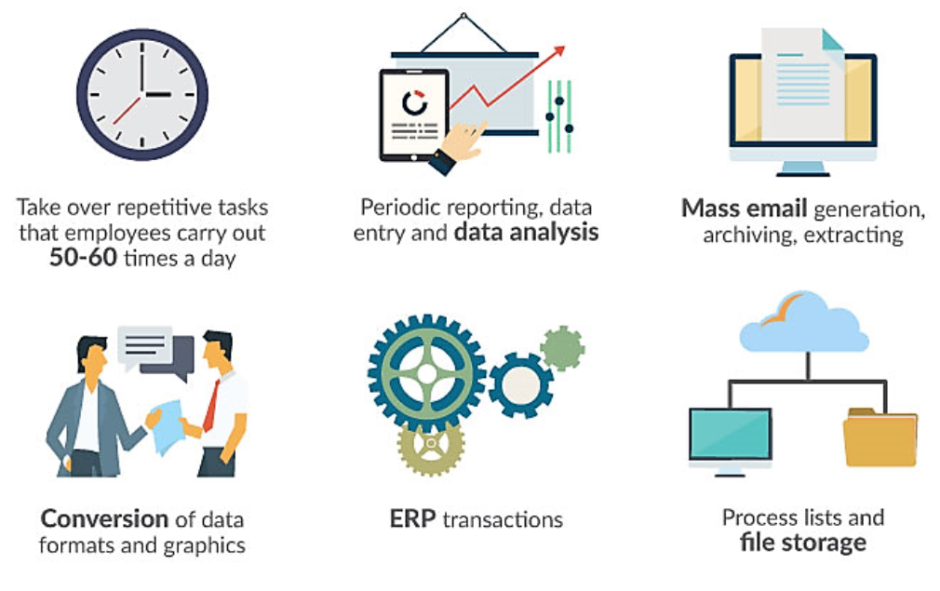
Industry Scenarios of RPA

Slide 11
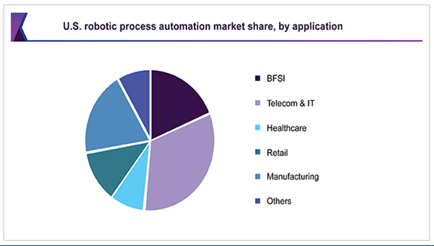
Industry Scenarios of RPA (Contd..)
BFSI
Telecom Industry
Health Sector
Financial Services
Logistics
Capital Market
Utilities & Energy

Slide 12
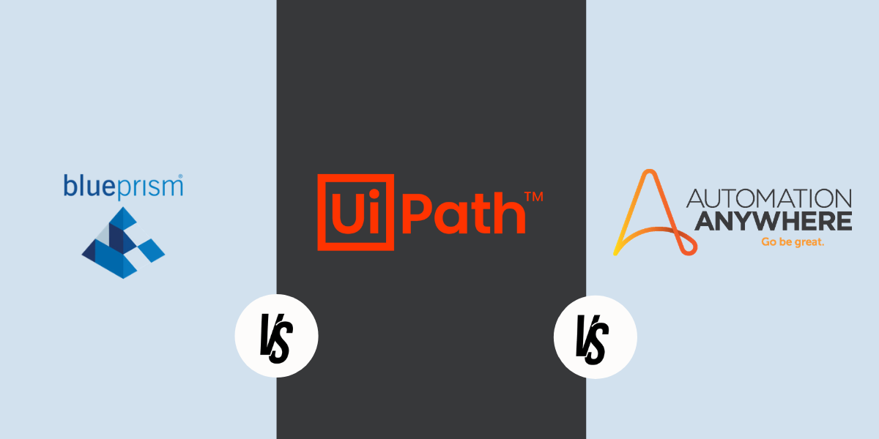
RPA TOOLS/PLATFORMS

Slide 13
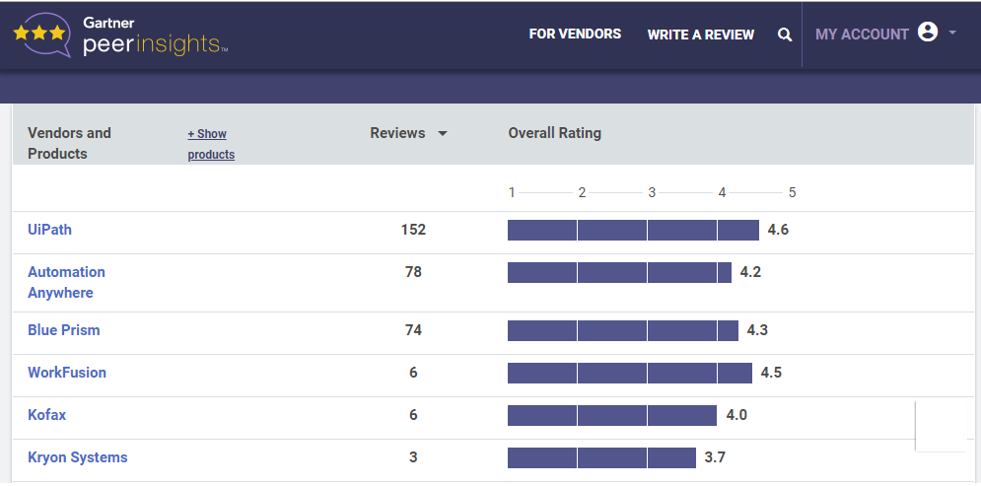
REVIEWS ON TOOLS/PLATFORMS (Contd..)

Slide 14
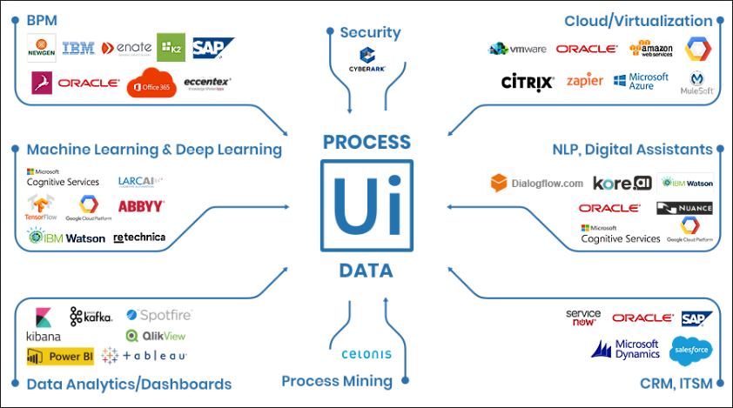
DOMAIN SPECIFIC APPLICATION of UiPath StudioX

Slide 15
TOPIC 1
END
THANK YOU

